Slide 1

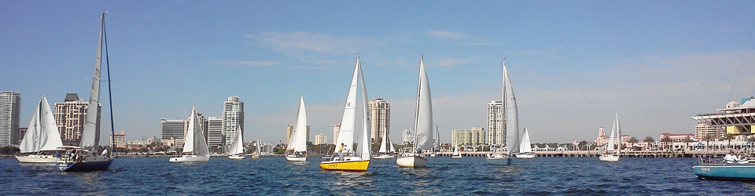
Introduction to
Sailboat Racing
Procedures and Rules
St. Petersburg Sailing Association

Slide 2
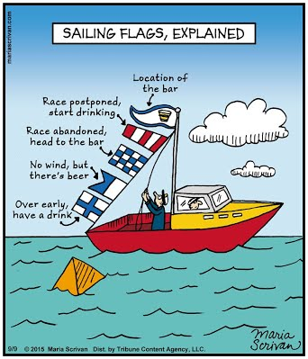
So Where is the Race ? and
How is it Run?
What’s the course?
When do I start?
What are the rules?

Slide 3
Contents
Notices and Sailing Instructions
Terms and Definitions
Starting Sequence
Basic Rules

Slide 4
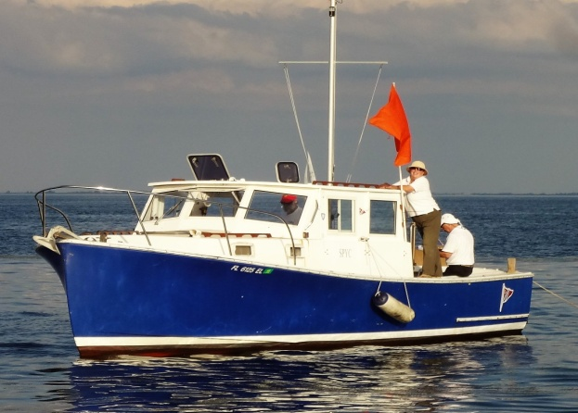
Basic Terms and Definitions
RC
RACE COMMITTEE
The race committee runs the races in accordance with the rules. They set the course, display the starting signals, record the finish positions and do many other things to make the race safe and fair.
Before the Race begins you need to CHECK-IN with RC. Tell them your:
- Boat Name
- Sail Number
- Class (Spinnaker or Cruising)
In SPSA races the RC uses VHF Ch. 72 for communication

Slide 5
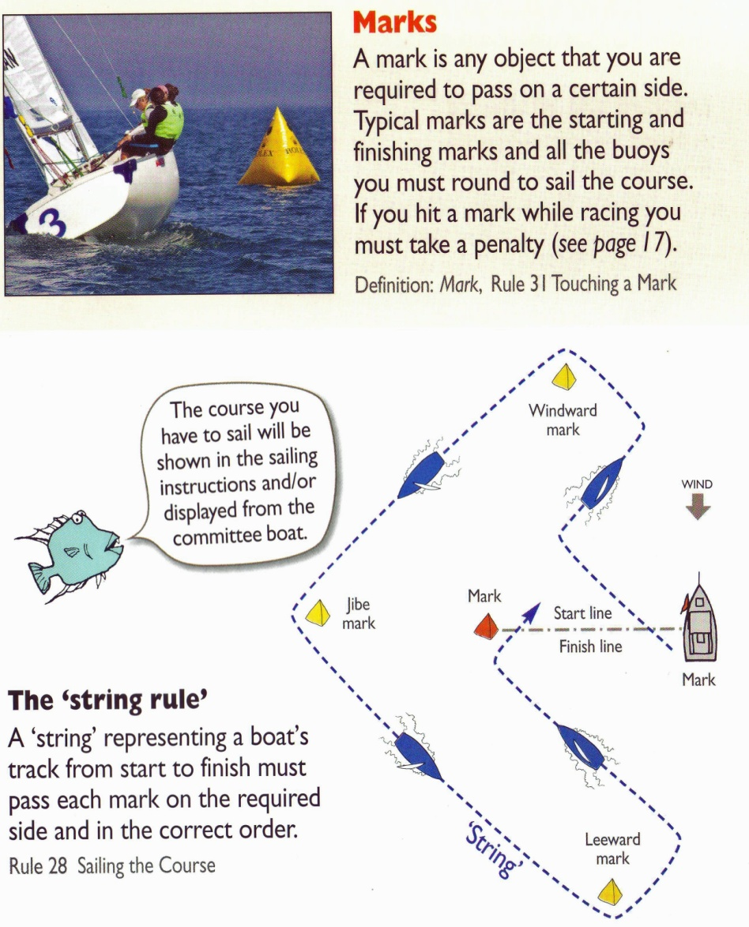
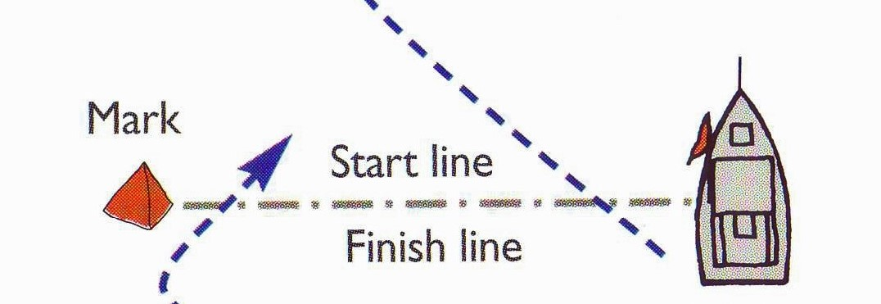
Basic Terms and Definitions
MARK
SPSA will often use Government Marks
STARTING LINE
The Starting Line is defined by an orange flag on the RC boat and a mark. To start properly, you must approach from the “pre-start side” of the line and pass between the RC and the mark after the “Starting” signal is made.

Slide 6
Basic Terms and Definitions
COURSE
The Course has a starting line, a finish line and a series of marks that must be “rounded” on a specified side. In the example here, all marks are to Starboard.

Slide 7
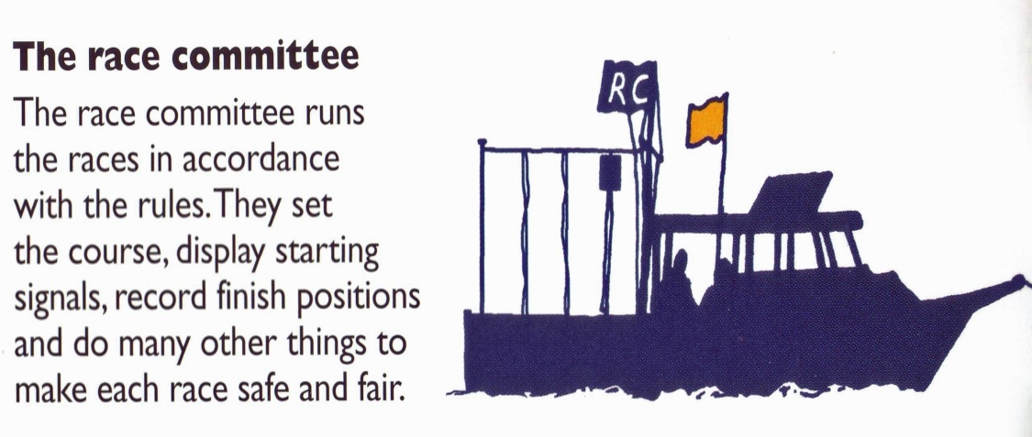
Basic Terms and Definitions
Mark
Race Committee
RC
Course
Before the Race begins you need to Check-In with RC
- Boat Name
- Sail Number
- Class
Starting Sequence
- Get Ready
- On Your Mark
- Get Set
- GO!

Slide 8
Basic Terms and Definitions
Mark
Race Committee
RC
Course
Before the Race begins you need to Check-In with RC
- Boat Name
- Sail Number
- Class
Starting Sequence
- Get Ready
- On Your Mark
- Get Set
- GO!

Slide 9
Starting Sequence
Notices and Sailing Instructions
Terms and Definitions
Starting Sequence
Basic Rules

Slide 10

Flag Commonly Displayed Before the Start of a Race
“L” Flag
COME WITHIN HAIL
Check in with the Race Committee
This flag is lowered approx. 1 minute prior to warning signal

Slide 11

Another Flag that Might Be Displayed Before the Start of a Race
Answering Pennant (AP)
POSTPONEMENT
The race will not begin as scheduled
This flag can be raised any time prior to the actual start including on shore. It is accompanied by 2 signal sounds.
When this flag is lowered on the water, the starting sequence will begin in approx. 1 minute. It is accompanied by 1 signal sound.

Slide 12

Flags Used to
Start the Race
SPSA CLASS FLAG
This flag is raised exactly 5 minutes before the start. It is accompanied by one signal sound.
This flag remains raised during the entire starting sequence.
This flag is lowered exactly 5 minutes after it is raised indicating the start of the race. Lowering the flag is accompanied by one signal sound.

Slide 13

Flags Used to
Start the Race
“P” Flag
PREPARATORY SIGNAL
This flag is raised exactly 1 minute after the SPSA Class flag is raised (4 minutes before the start). It is accompanied by one signal sound.
This flag is lowered exactly 3 minutes after it is raised. Indicating exactly 1 minute before the start of the race. Lowering the flag is accompanied by one long signal sound.

Slide 14
SPSA Starting Sequence
COME WITHIN HAIL- Check-in with the Race Committee. This flag is lowered approx. 1 minute prior to warning signal
5 MINUTES TO START
WARNING—1 sound, SPSA Class flag raised
4 MINUTES TO START
PREPARATORY—1 sound, P flag raised
1 MINUTES TO START
ONE MINUTE—1 long sound, P flag lowered
START
0 MINUTES TO START
STARTING—1 sound, SPSA Class flag lowered

Slide 15
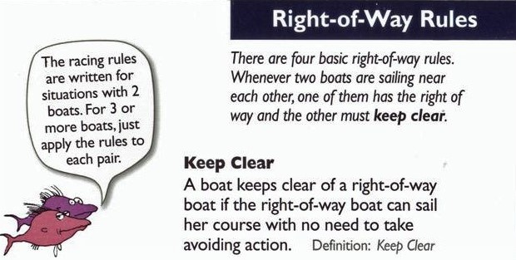
4 Basic
Right of Way Rules
Keep Clear

Slide 16
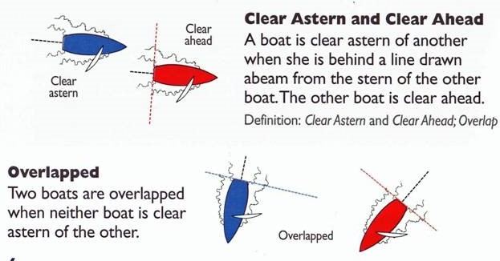
Definitions
Clear Ahead and ClearAstern
Overlapped

Slide 17
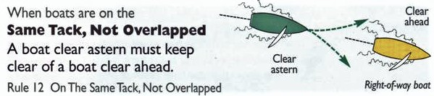
Right of Way Rules #1
Same Tack, Not Overlapped

Slide 18
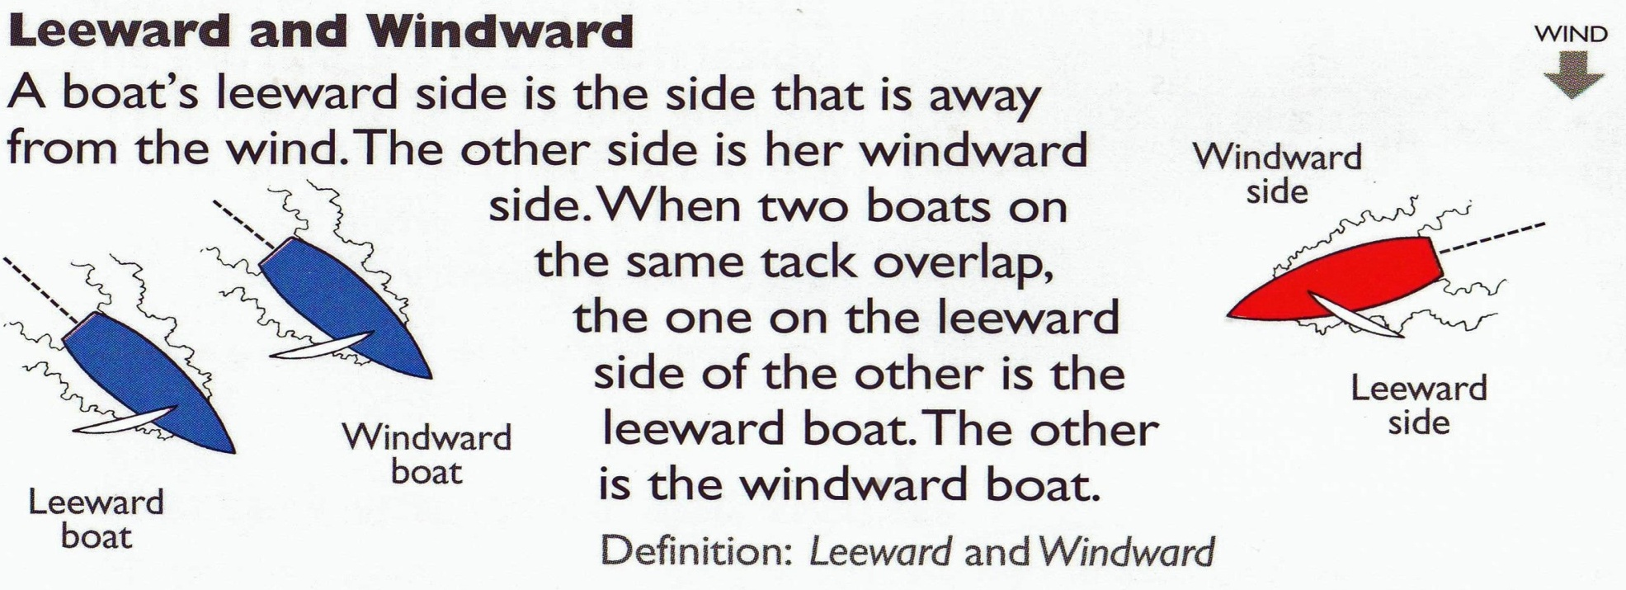
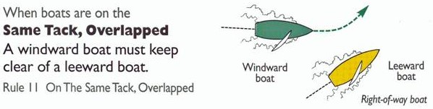
Definitions
Leeward and Windward
Right of Way Rules #2
Same Tack - Overlapped

Slide 19
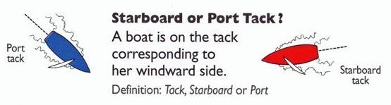
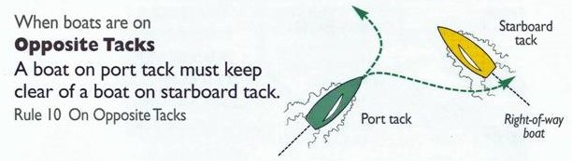
Definitions
Starboard or Port Tack
Right of Way Rules #3
Opposite Tack

Slide 20
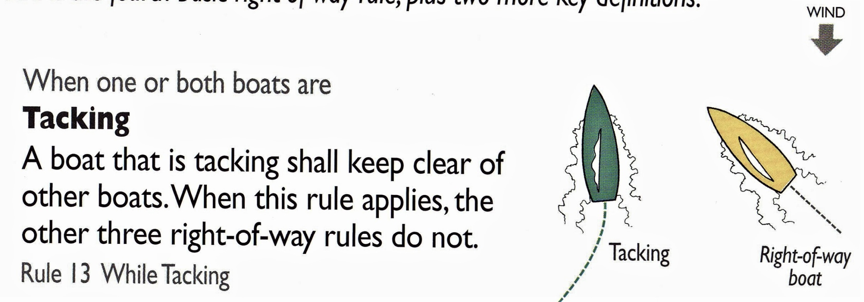
Right of Way Rules #4
Tacking

Slide 21
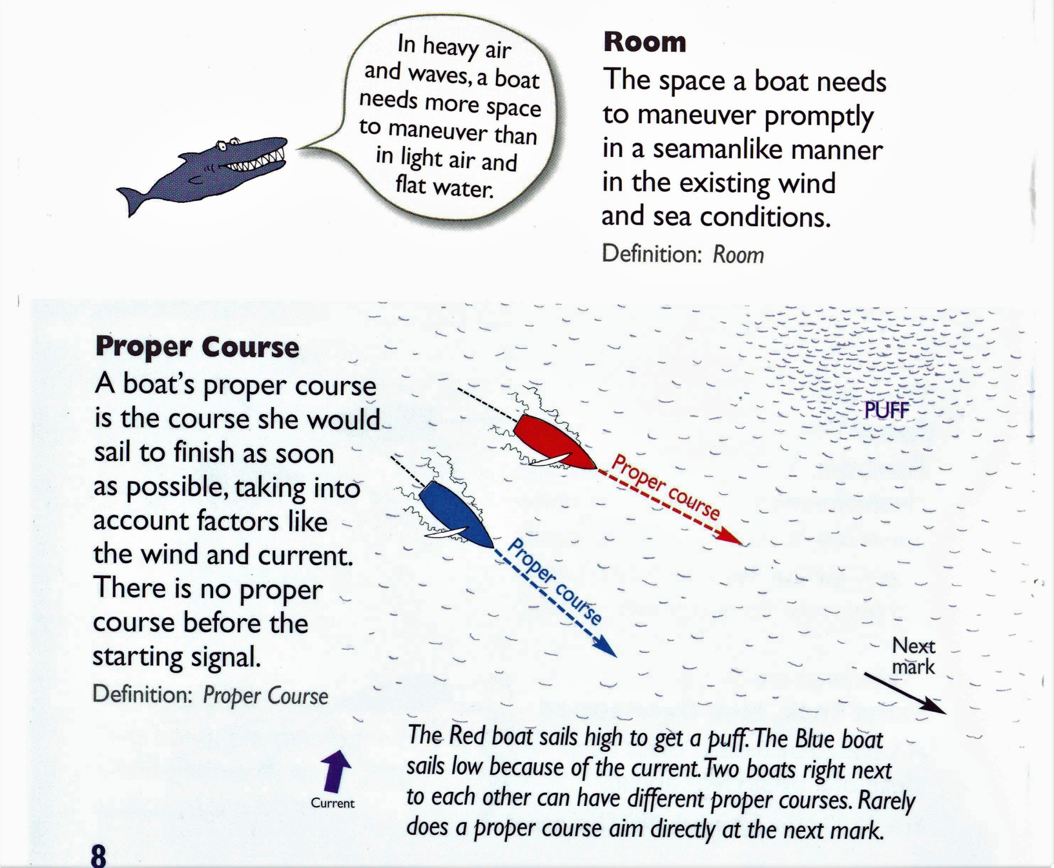
Definitions
Room
Proper Course

Slide 22
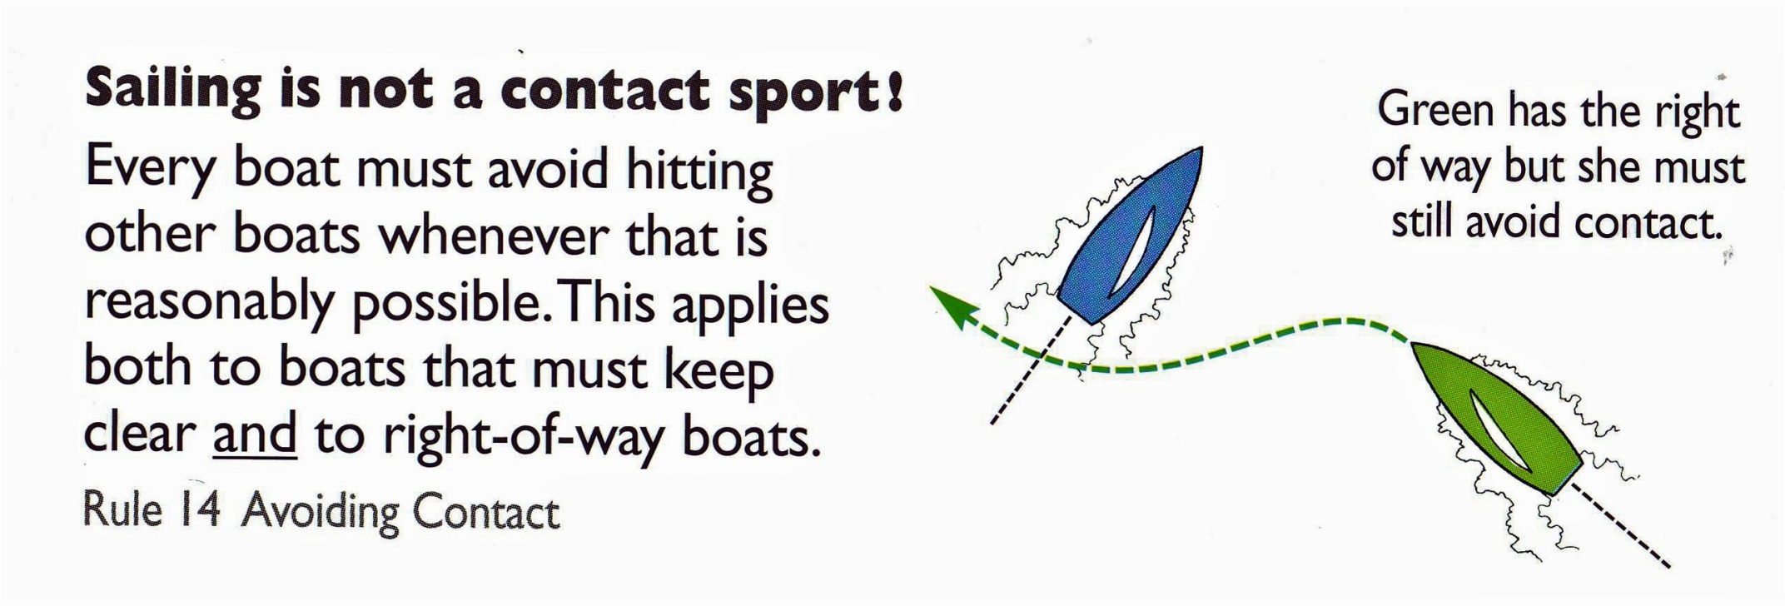
Limitations
Sailing is NOT a Contact Sport
Even when a boat has the right of way, there are limitations on what she can do!

Slide 23
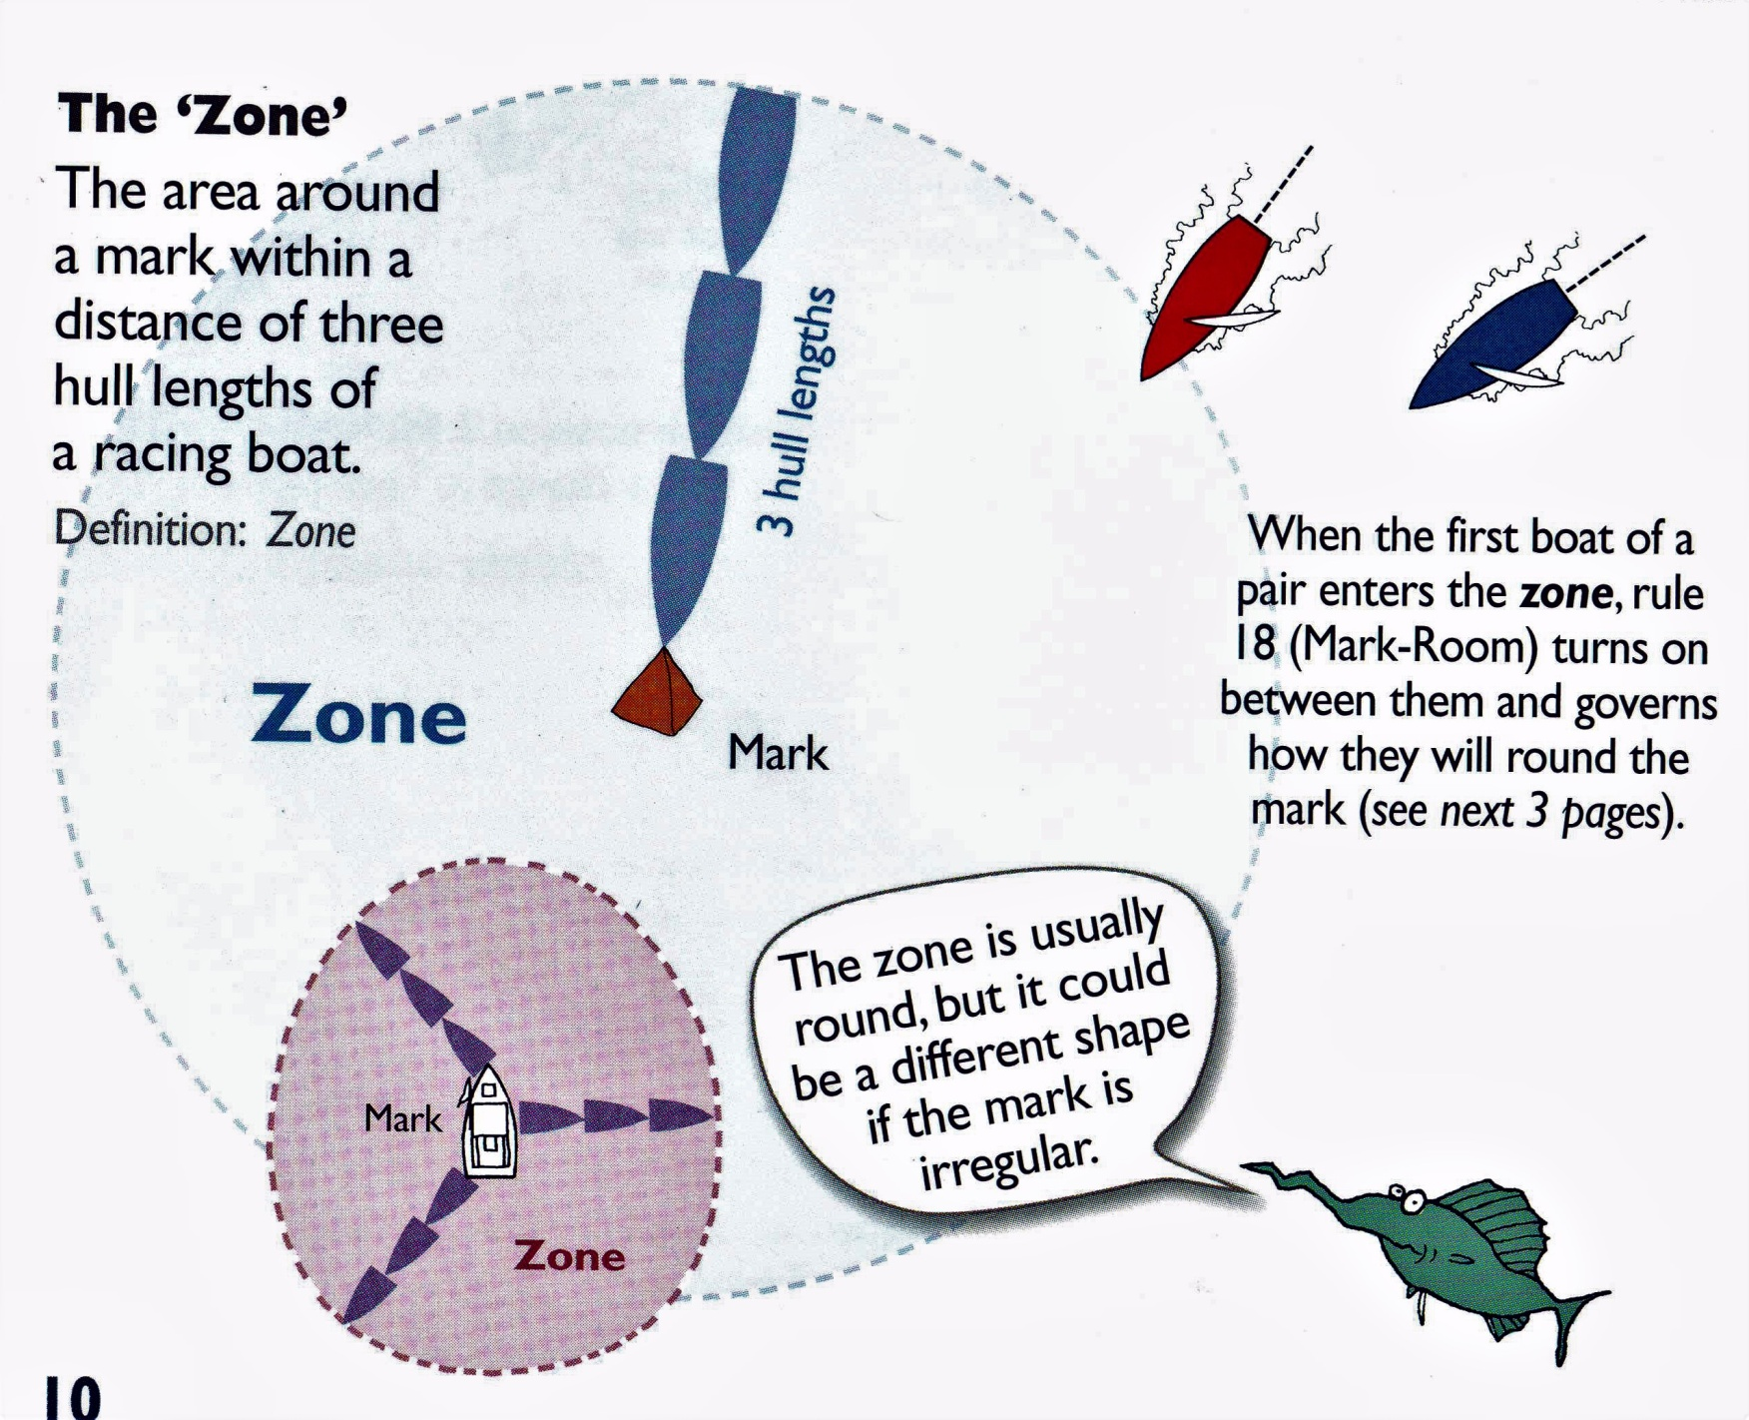
Definitions
The Zone
Mark Room

Slide 24
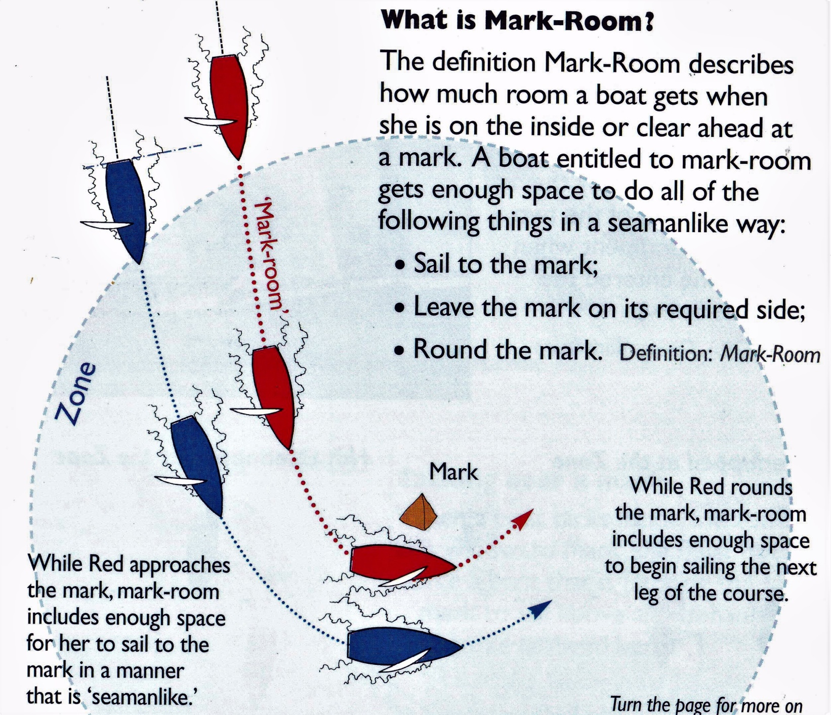
Definitions
Mark Room

Slide 25
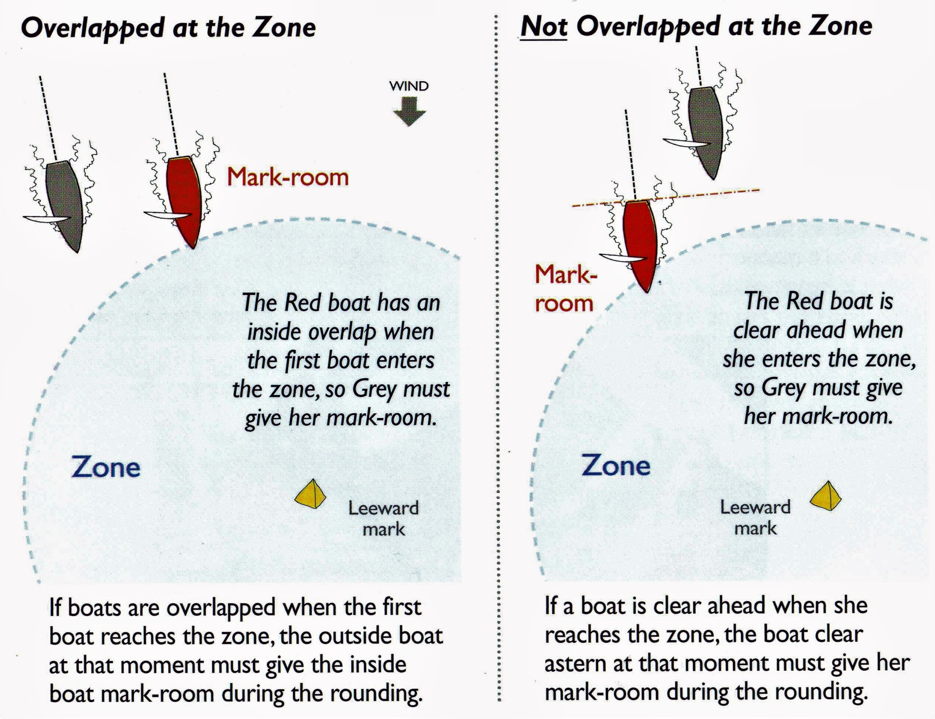
Rules at the Mark

Slide 26
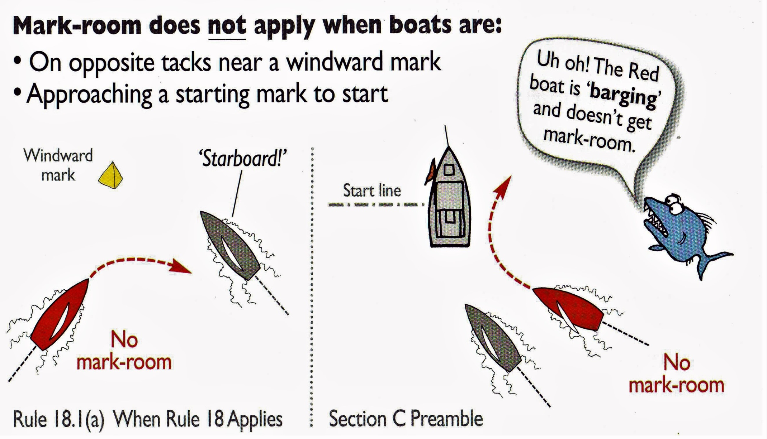
Rules at the Mark
Mark Room

Slide 27
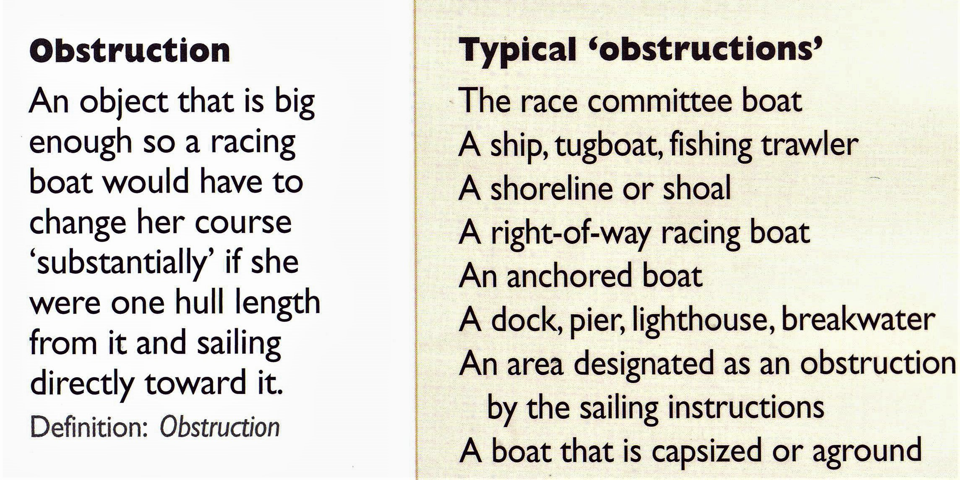
Definitions
Obstruction

Slide 28
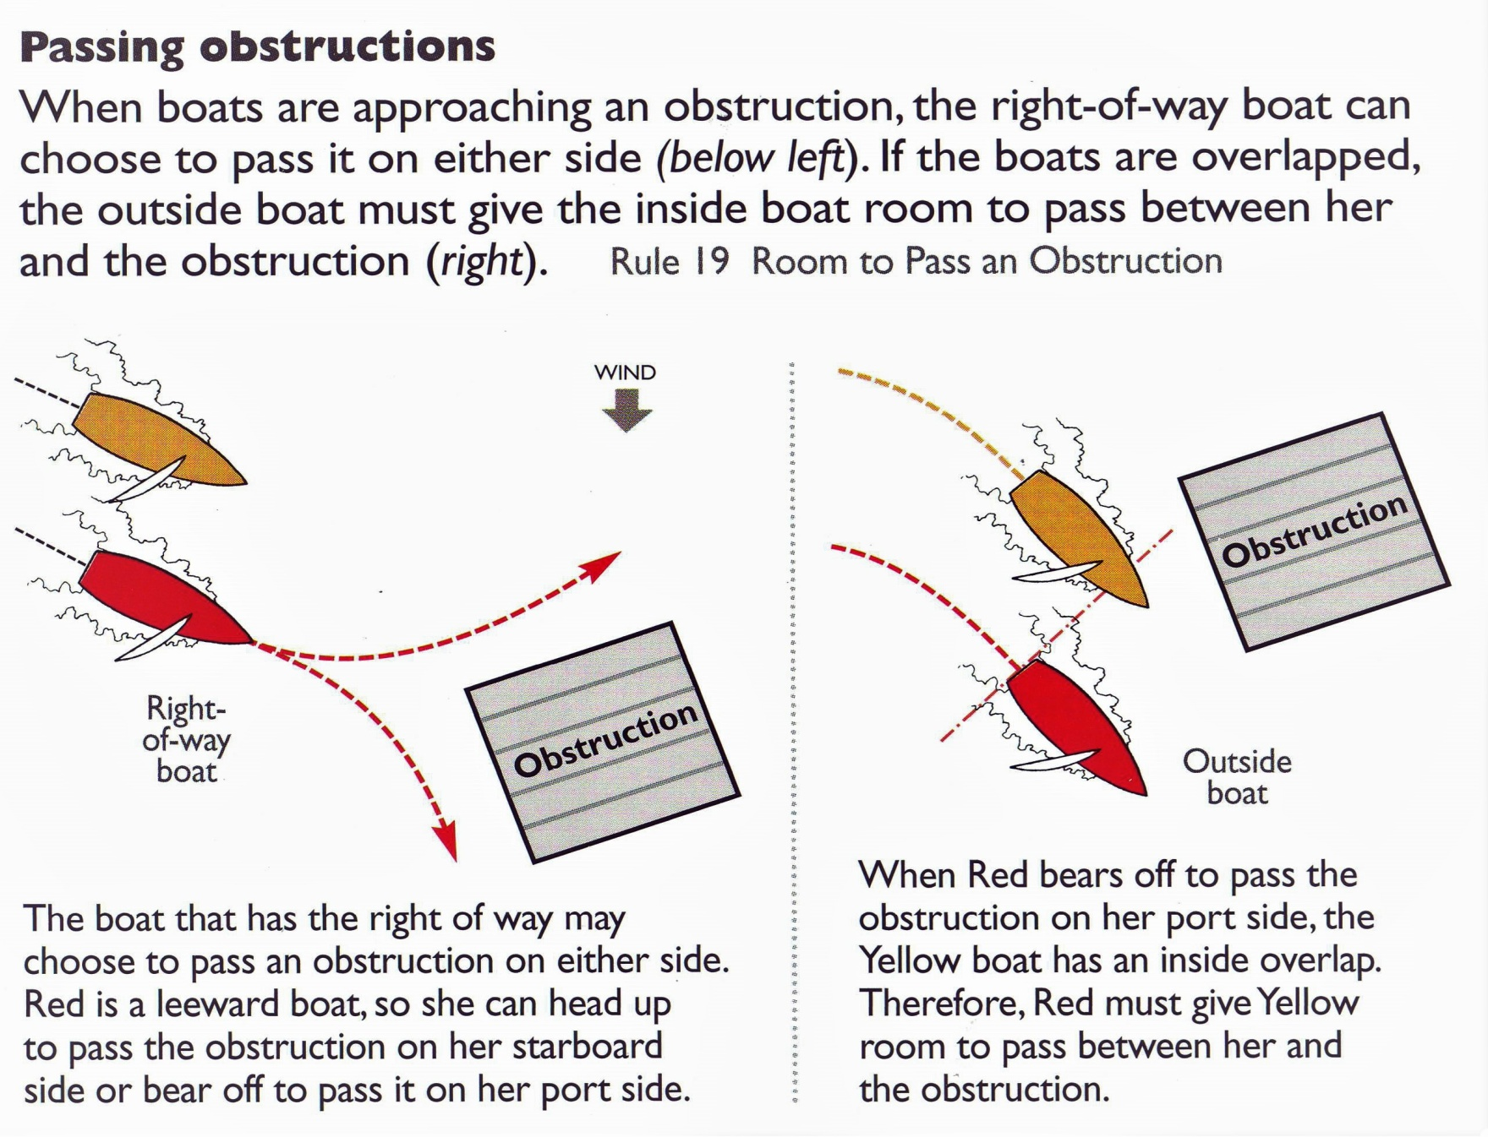
Rules at Obstructions

Slide 29
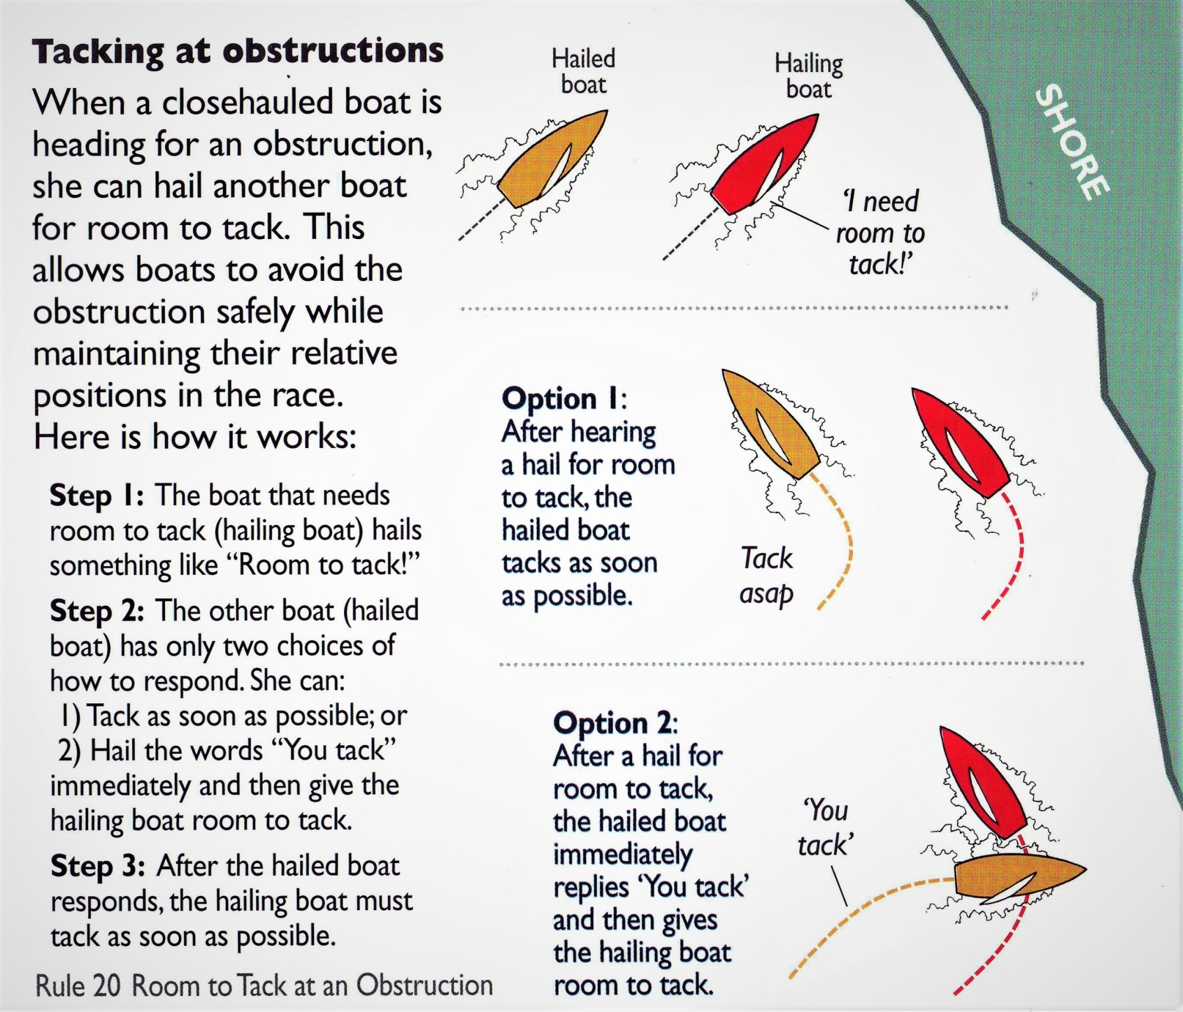
Rules at Obstructions

Slide 30
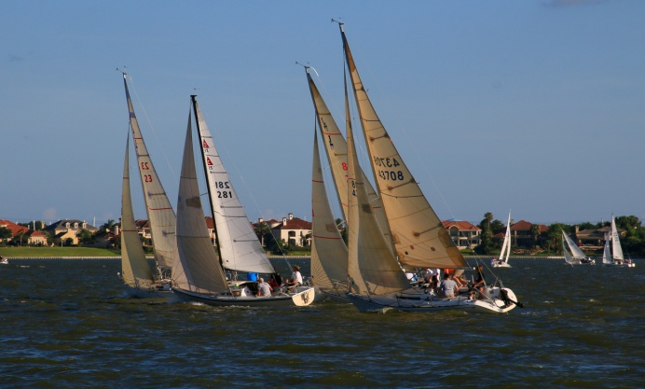
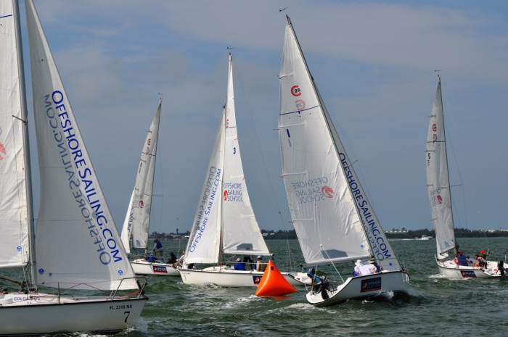
Right of Way Summary
Right of Way Boat
Right of Way Rules
  Clear Ahead/Clear Astern
  Leeward/Windward
  Starboard/Port
  Tacking
Room at the Mark
Avoiding Obstructions

